Slide 1







AMERICAN INTERNATIONAL UNIVERSITY-BANGLADESH
Course Name: Engineering Shop
Section: D
Semester: Summer 2021-2022
Course Teacher: Nuzat Nuary Alam
Presented By
Group: 01
MD. SAMIN ANJUM
19-39434-1
RUPA PAUL
19-41050-2
NAGVI NAZAM
19-40422-1
MAHMUD HASAN
17-33881-1
SHAILA KABIR
17-35642-3

Slide 2
Presentation On

Slide 3
Timeline:
Date Task | July 06-11 | July 11-17 | July 17-23 | July 23-29 | July 29-August-06 | August 06-11
Topic Selection
Preparing Project Repots and Submit
Optimizing Circuits and Software work
Project Report Writing
Submission of Project And Report
Attending Final And Presenting the Project

Slide 4
Table of Contents:
Purpose
Introduction
How to recharge a lead acid battery?
Components of lead acid battery charger circuit
Component description
Circuit diagram
Circuit explanation
Cost analysis
Advantages & disadvantages
conclusion

Slide 5
Purpose:
The purpose of this project is concern with any battery is it discharges over time and must be recharged so that it can provide the necessary voltage and current.

Slide 6
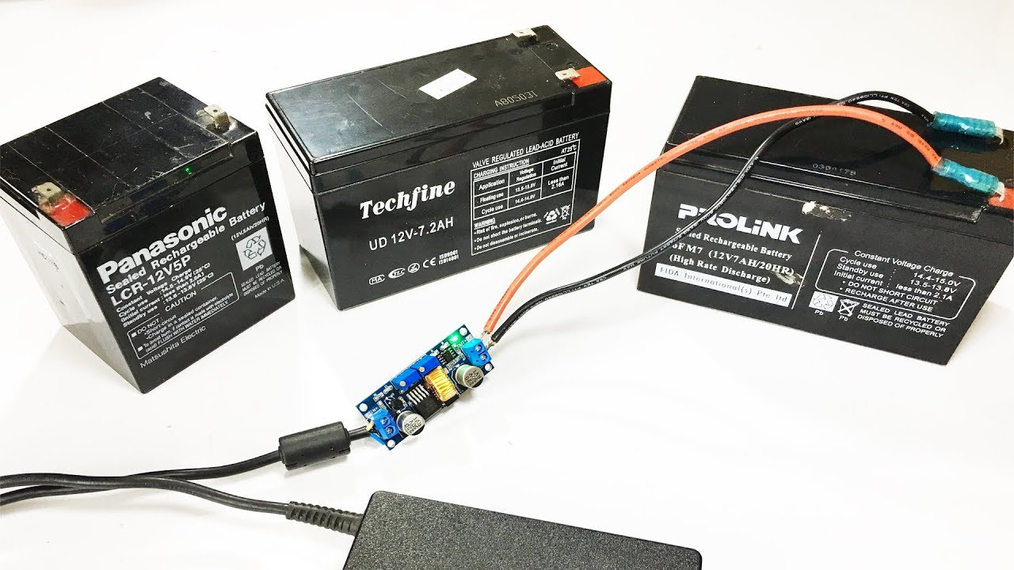
Introduction :
The battery which utilizations wipe endlessly lead peroxide for the change of the compound energy into electrical power, such kind of battery is known as a lead acid battery. Due to low cost (for the capacity) compared to newer battery technologies and the ability to provide high surge currents (an important factor in automobiles), lead acid batteries are still the preferred choice of batteries in almost all vehicle.

Slide 7
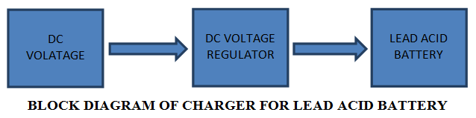
How to recharge a LEAD ACID BATTERY :
To charge a battery from AC we really want a stage down transformer, a rectifier, filtering circuit, regulator to keep up with the constant voltage.

Slide 8
Components of Lead Acid Battery Charger Circuit :
7805 VOLTAGE REGULATOR
Resistor
Diode
LED
LEAD ACID BATTERY
PCB BOARD

Slide 9
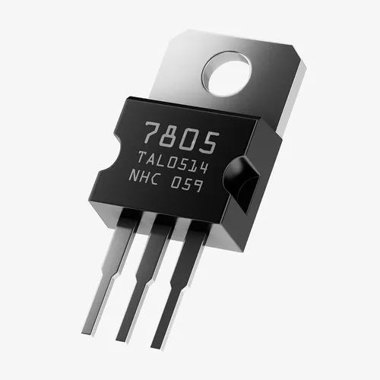
Component Description:
7805 : The 7805 is a part of the 78XX series of linear voltage regulators.

Slide 10
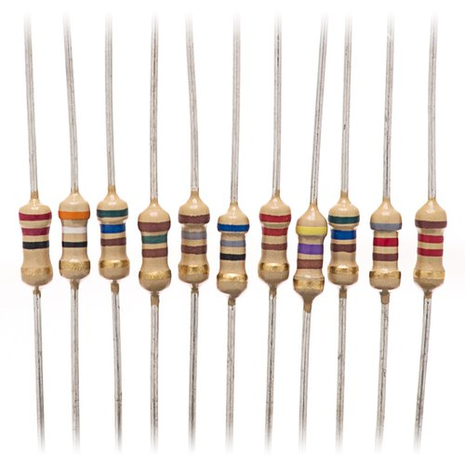
Resistor:
A resistor is a passive two-terminal electrical component that implements electrical resistance as a circuit element.

Slide 11
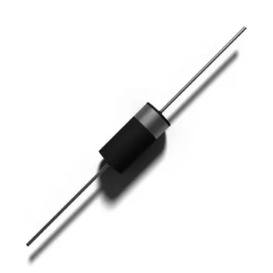
Diodes:
Diodes Incorporated is a leading global manufacturer and supplier of high-quality application specific standard products.

Slide 12
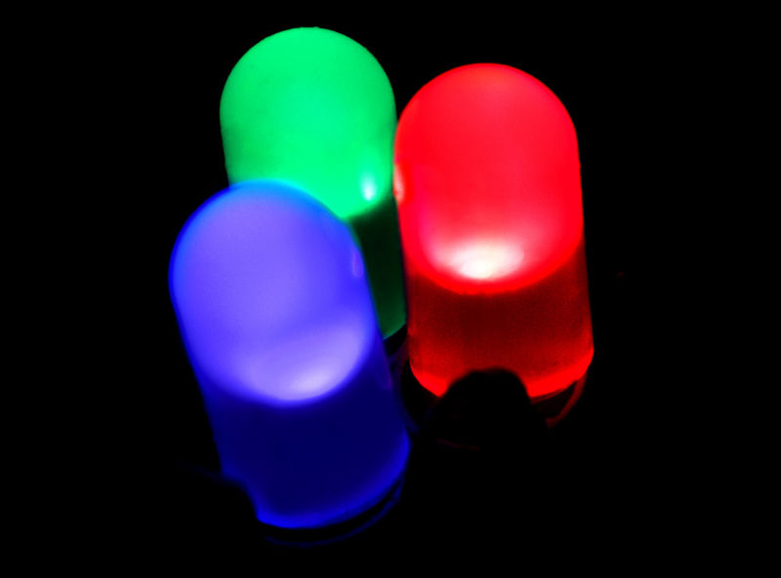
LED:
A light-emitting diode (LED) is a semiconductor light source that emits light when current flows through it.

Slide 13
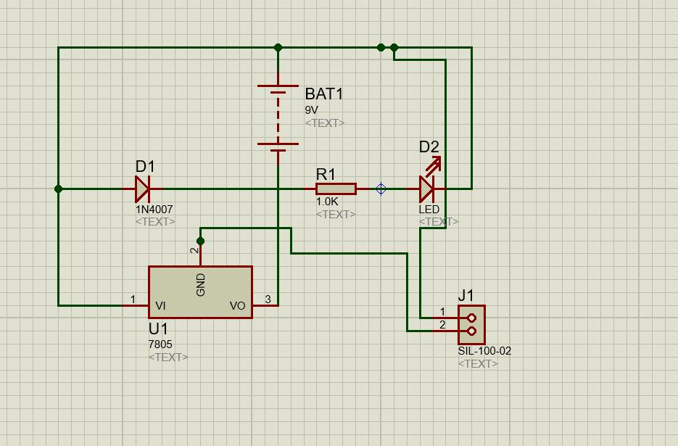
Circuit diagram(Simulation :
Fig: Schematic Diagram

Slide 14
Circuit explanation:
first of all we select the component for lead charging system7805 Voltage, 1k resistor 1N4007 Diodes, Led, Battery, PCB Board and Draw a schematic design and by placing the component design a PCB Layout
the diode resistor and 7805 are placing to junction and 12 V lead battery
In PCB board we implement our circuit following our design
after placing the component we soldering the circuit and then connect to the battery and charging a phone

Slide 15
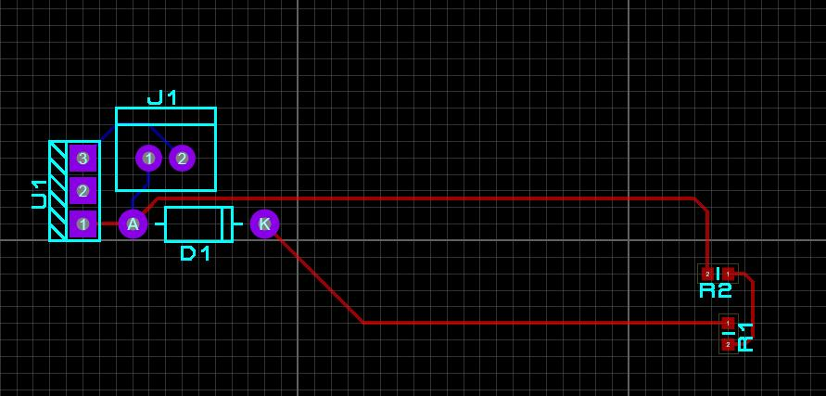
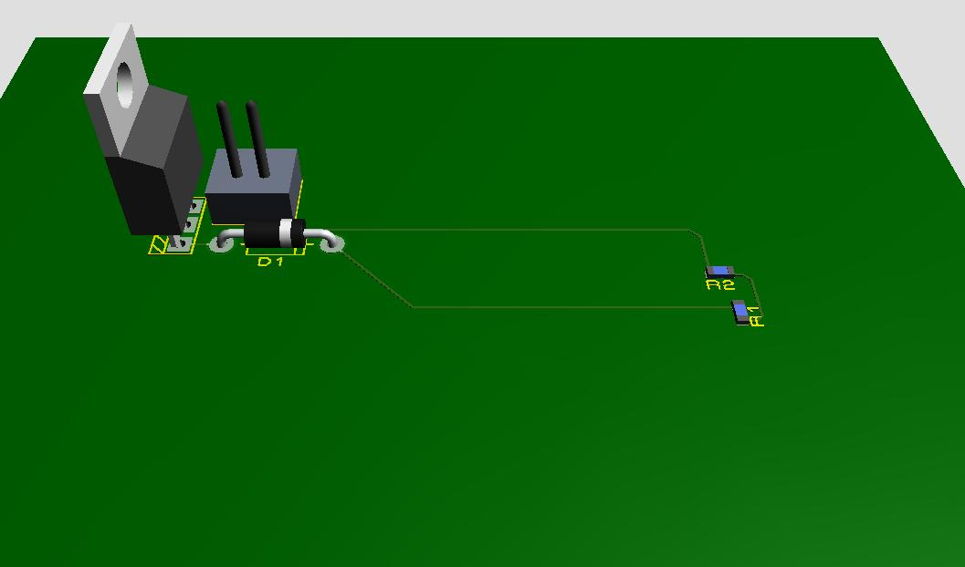
Fig: PCB LAYOUT
Fig: 3D VIEW

Slide 16
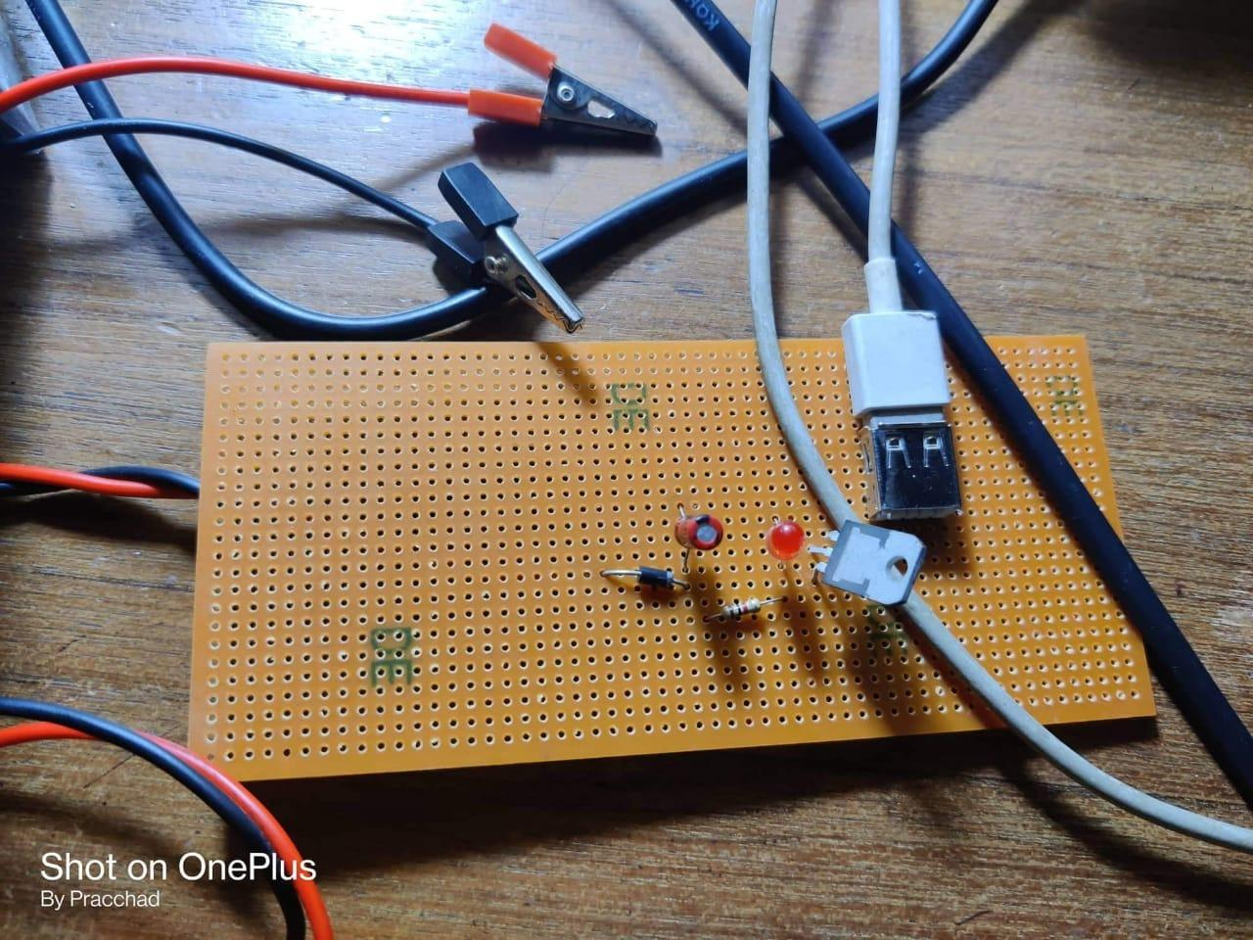
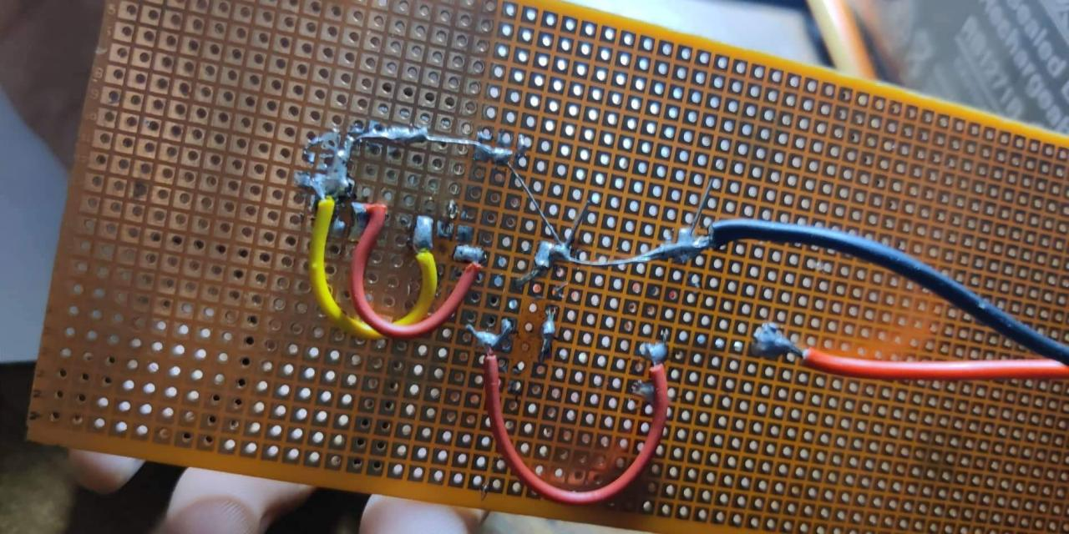
HARDWARE :
Fig : Lead battery charger Circuit

Slide 17

DEMOSTRATION

Slide 18
Cost Analysis:
Components | Estimate Price
7805 Voltage regulator | 20 Tk
1K Resistor | 5 Tk
1N4007 Diode | 15 Tk
LED*1 | 5 Tk
Lead Acid Battery | 350 Tk
PCB Board | 30 Tk
Total | 425 Tk

Slide 19
Advantages :
Inexpensive ;
simple to manufacture ;
Mature, reliable and well-understood technology ;
Capable of high discharge rates ;
The self-discharge is among the lowest of rechargeable battery systems.

Slide 20
Disadvantages :
Low energy density ;
Thermal runaway can occur if improperly charged ;
cannot be stored in a discharged condition ;
Transportation restrictions on flooded lead acid - there are environmental concerns regarding spillage ;
Allows only a limited number of full discharge cycles.

Slide 21


Slide 22


Slide 23


